Slide 1
NextHikes Solution
Bike Sharing Demand Analysis Project Using Excel
Summary describing methods, findings, and recommendations.
By Priyanka Kothari.

Slide 2
Project Overview
This project loads, cleans, and analyzes bike-sharing datasets to show how weather, time, and holidays affect rentals. Deliverables include a cleaned dataset, aggregated analysis, charts.

Slide 3
Data Loading & Cleaning With Exploratory Analysis
Datasets loaded from the provided Excel files. Merged on common keys where available (instant, dteday, hr). Missing dates were coerced to datetime; duplicates removed. Rows with critical missing fields are flagged for manual review.
Derived features added: weekday (1=Mon), is_weekend (True/False), date, season_name (where season present), and cnt (registered+casual).
Aggregations included average rentals by hour, weekday, and season. Charts saved in the charts sheet illustrate hourly and weekly demand patterns..

Slide 4
Average Rentals By Hour
Hour of Day | Average of cnt
0 | 16.34883721
1 | 10.69767442
2 | 7.170731707
3 | 4.870967742
4 | 2.15625
5 | 4.205128205
6 | 19.57142857
7 | 54.39534884
8 | 128.2857143
9 | 87.42857143
10 | 53.64285714
11 | 59.38095238
12 | 76.34883721
13 | 78.51162791
14 | 74.41860465
15 | 77.95348837
16 | 89.27272727
17 | 140.2045455
18 | 122.8604651
19 | 85.13953488
20 | 61.76744186
21 | 46.41860465
22 | 35.06976744
23 | 25.18604651
(blank)
Grand Total | 58.304

Slide 5
Average Rentals By Weekday
Weekday | Average of cnt | weekday | Average Rentals
Monday | 56.7114094 | Monday | 56.7114094
Tuesday | 66.00787402 | Tuesday | 66.00787402
Wednesday | 61.44274809 | Wednesday | 61.44274809
Thursday | 67.664 | Thursday | 67.664
Friday | 65.9057971 | Friday | 65.9057971
Saturday | 46.6746988 | Saturday | 46.6746988
Sunday | 49.51829268 | Sunday | 49.51829268
(blank)
Grand Total | 58.304

Slide 6
Average Rentals By Season
Season | Average of cnt
Spring | 58.304
(blank)
Grand Total | 58.304

Slide 7
Daily_TimeSeries (Forecast)
dteday | Sum of cnt
01-01-2011 | 985
02-01-2011 | 801
03-01-2011 | 1349
04-01-2011 | 1562
05-01-2011 | 1600
06-01-2011 | 1606
07-01-2011 | 1510
08-01-2011 | 959
09-01-2011 | 822
10-01-2011 | 1321
11-01-2011 | 1263
12-01-2011 | 1162
13-01-2011 | 1406
14-01-2011 | 1421
15-01-2011 | 1248
16-01-2011 | 1204
17-01-2011 | 1000
18-01-2011 | 683
19-01-2011 | 1650
20-01-2011 | 1927
21-01-2011 | 1543
22-01-2011 | 981
23-01-2011 | 986
24-01-2011 | 1416
25-01-2011 | 1985
26-01-2011 | 506
27-01-2011 | 431
28-01-2011 | 1167
29-01-2011 | 1098
30-01-2011 | 1096
31-01-2011 | 1501
Grand Total | 38189
dteday | Sum of cnt | Forecast(Sum of cnt) | Lower Confidence Bound(Sum of cnt) | Upper Confidence Bound(Sum of cnt)
01-01-2011 | 985
02-01-2011 | 801
03-01-2011 | 1349
04-01-2011 | 1562
05-01-2011 | 1600
06-01-2011 | 1606
07-01-2011 | 1510
08-01-2011 | 959
09-01-2011 | 822
10-01-2011 | 1321
11-01-2011 | 1263
12-01-2011 | 1162
13-01-2011 | 1406
14-01-2011 | 1421
15-01-2011 | 1248
16-01-2011 | 1204
17-01-2011 | 1000
18-01-2011 | 683
19-01-2011 | 1650
20-01-2011 | 1927
21-01-2011 | 1543
22-01-2011 | 981
23-01-2011 | 986
24-01-2011 | 1416
25-01-2011 | 1985
26-01-2011 | 506
27-01-2011 | 431
28-01-2011 | 1167
29-01-2011 | 1098
30-01-2011 | 1096
31-01-2011 | 1501
01-02-2011 | 1360
02-02-2011 | 1526
03-02-2011 | 1550
04-02-2011 | 1708
05-02-2011 | 1005
06-02-2011 | 1623
07-02-2011 | 1712
08-02-2011 | 1530
09-02-2011 | 1605
10-02-2011 | 1538
11-02-2011 | 1746
12-02-2011 | 1472
13-02-2011 | 1589
14-02-2011 | 151 | 151 | 151.00 | 151.00
15-02-2011 |  | 1387.216744 | 585.51 | 2188.93
16-02-2011 |  | 1392.559775 | 586.77 | 2198.35
17-02-2011 |  | 1397.902805 | 587.97 | 2207.83
18-02-2011 |  | 1403.245836 | 589.12 | 2217.37
19-02-2011 |  | 1408.588866 | 590.20 | 2226.97
20-02-2011 |  | 1413.931896 | 591.23 | 2236.64
21-02-2011 |  | 1419.274927 | 592.19 | 2246.36
22-02-2011 |  | 1424.617957 | 593.10 | 2256.14
23-02-2011 |  | 1429.960988 | 593.95 | 2265.97
24-02-2011 |  | 1435.304018 | 594.74 | 2275.87
25-02-2011 |  | 1440.647049 | 595.46 | 2285.83
26-02-2011 |  | 1445.990079 | 596.14 | 2295.84

Slide 8
Average Rentals By Weather
Weathersit_name | Average of cnt
1 | 58.31961259
Clear | 58.31961259
2 | 55.42222222
Mist/Cloudy | 55.42222222
3 | 32.59183673
Light Rain/Snow | 32.59183673
4 | 36
Heavy Rain/Storm | 36
Grand Total | 55.50726744

Slide 9
Total User(Casual+Registered)
Row Labels | Sum of casual | Sum of registered | Sum of cnt
Spring | 3073 | 35116 | 38189
Grand Total | 3073 | 35116 | 38189

Slide 10
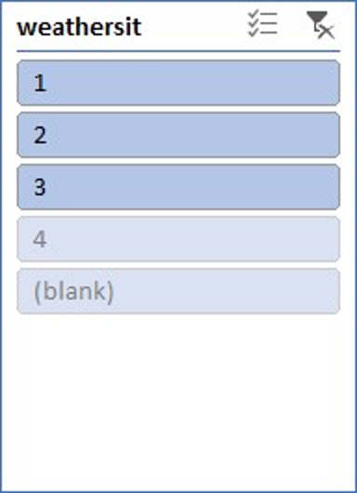
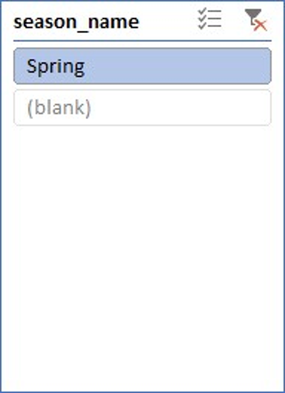
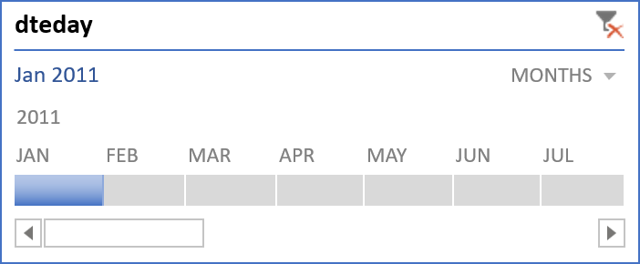
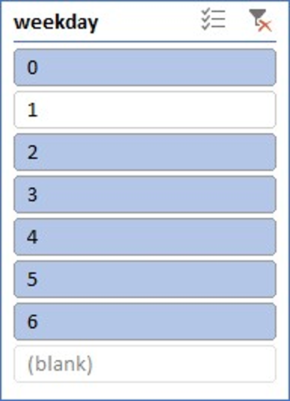
Slicers and Timeline
Hour of Day | Sum of casual | Sum of registered | Sum of cnt
0 | 41 | 356 | 397
1 | 33 | 235 | 268
2 | 19 | 166 | 185
3 | 22 | 66 | 88
4 | 4 | 30 | 34
5 | 2 | 84 | 86
6 | 12 | 385 | 397
7 | 31 | 1132 | 1163
8 | 70 | 2742 | 2812
9 | 86 | 1851 | 1937
10 | 108 | 1140 | 1248
11 | 211 | 1176 | 1387
12 | 255 | 1600 | 1855
13 | 274 | 1622 | 1896
14 | 245 | 1548 | 1793
15 | 284 | 1612 | 1896
16 | 278 | 1930 | 2208
17 | 200 | 3077 | 3277
18 | 123 | 2644 | 2767
19 | 119 | 1925 | 2044
20 | 78 | 1361 | 1439
21 | 60 | 961 | 1021
22 | 57 | 768 | 825
23 | 55 | 524 | 579
Grand Total | 2667 | 28935 | 31602

Slide 11

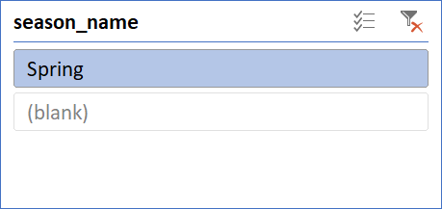
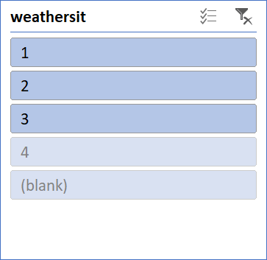
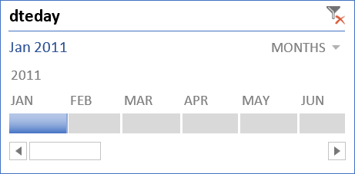
Bike Sharing Demand Analysis Dashboard
Total User :
38189
Avearge Rentals By Hour
Avearge Rentals By Weekday
Avearge Rentals By Season
Avearge Rentals By Weathersit
Total Causal and Registered User
Daily Time Series Forecast
Filter Panel

Slide 12
Thank You !

